Slide 1
Seminar 2 Week 2 COS70008 – Technology Innovation Research and Project

Slide 3
Literature Review
Content
Literature Review – The What and Why
Planning a Literature Review
Searching & Locating Articles
Reviewing Articles
SCIENCE | TECHNOLOGY | INNOVATION | BUSINESS | DESIGN

Slide 4

Literature Review
Literature Review – The WHAT and the WHY!
SCIENCE | TECHNOLOGY | INNOVATION | BUSINESS | DESIGN

Slide 5
Literature Review
Literature Review: The What and Why
Literature Review is an account of what has been published on a topic by accredited scholars and researchers.
It is a piece of discursive prose that sheds light on, and enlarges our knowledge about, a topic
The purpose is to convey to your reader what knowledge and ideas that have been established on a topic, and to evaluate their strengths and weaknesses.
SCIENCE | TECHNOLOGY | INNOVATION | BUSINESS | DESIGN

Slide 6
Literature Review
Literature Review: The What and Why
Literature Review must be defined by a guiding concept, such as:
Your research objective
The problem or issue you are discussing
Your argumentative thesis (or essay)
Literature Review is NOT:
A descriptive list of the materials available
A list summarising one piece of literature after another
SCIENCE | TECHNOLOGY | INNOVATION | BUSINESS | DESIGN

Slide 7
Literature Review
Literature Review: The What and Why
Literature Review lets you gain and demonstrate skills in two areas:
Information seeking
The ability to scan the literature effectively
Using manual or computerised methods to identify a set of useful articles and publications
Critical appraisal
The ability to apply principles of analysis to identify unbiased and valid studies
SCIENCE | TECHNOLOGY | INNOVATION | BUSINESS | DESIGN

Slide 8
Literature Review
What a Literature Review Must Do
Be organised around and be related directly to the topic you are researching
Be a synthesised discussion of what is known and what is not known
Should help formulate questions that need further research
Must identify gaps that could lead to innovative application
SCIENCE | TECHNOLOGY | INNOVATION | BUSINESS | DESIGN

Slide 9

Planning a Literature Review
SCIENCE | TECHNOLOGY | INNOVATION | BUSINESS | DESIGN

Slide 10
Planning a Literature Review
General Questions of Interest
Nature of Literature Review
What is the specific problem or question that my reviews helps to define?
What type of literature review am I conducting?
What is the scope of my literature review?
SCIENCE | TECHNOLOGY | INNOVATION | BUSINESS | DESIGN

Slide 11
Planning a Literature Review
General Questions of Interest
Content of Articles
In what ways do the articles contribute to our understanding of the problem under study?
In what ways are they useful for practice?
What are the strengths and limitations?
How do they relate to the specific question I am developing?
SCIENCE | TECHNOLOGY | INNOVATION | BUSINESS | DESIGN

Slide 12
Searching & Locating Articles
SCIENCE | TECHNOLOGY | INNOVATION | BUSINESS | DESIGN

Slide 13
Searching and Locating articles
Articles, Sources & Search Methods
Articles
Number of articles
Types [Journals, conference papers, proceedings]
Relevance to topic
Sources (databases)
Scopus, Web of science, EBSCOhost, Swinburne Library, ACM, IEEE, etc.
Search Methods
Snowballing
Database matching (citations)
Database matching (keywords)
SCIENCE | TECHNOLOGY | INNOVATION | BUSINESS | DESIGN

Slide 14
Searching and Locating articles
Search Criteria, Process & Justifications
Search Criteria (Justifications)
Peer reviewed articles
Number of citations for the article
Citation index of author
Journal impact factor
Author affiliations, etc.
Search Process (Workbook / Reflection)
Discuss how you chose the keywords and WHY
Discuss the database(s) you searched and HOW
Discuss the criteria you applied
Present the result of your search (references)
SCIENCE | TECHNOLOGY | INNOVATION | BUSINESS | DESIGN

Slide 15
Searching and Locating articles
General Questions of Interest
What sources am I using?
How current, complete and unbiased is the source?
What types of articles are acceptable?
Academic refereed journal
Conference proceedings
Textbooks, Edited books
Professional and trade journals, etc.
Is the articles I am using peer reviewed?
SCIENCE | TECHNOLOGY | INNOVATION | BUSINESS | DESIGN

Slide 16
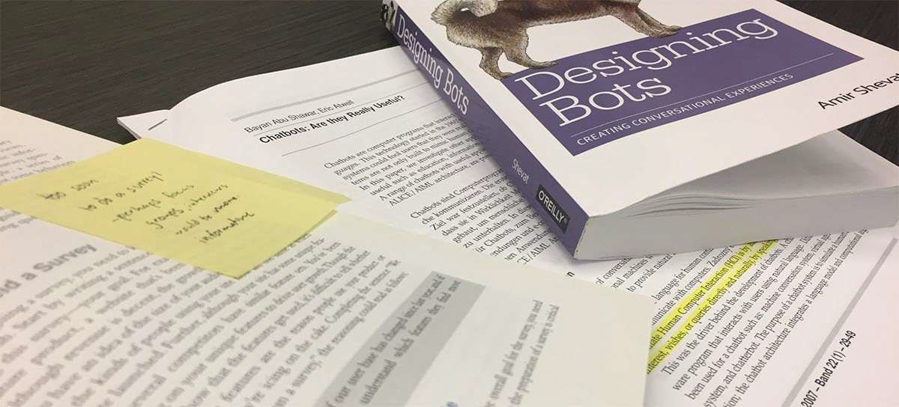
Reviewing Articles
SCIENCE | TECHNOLOGY | INNOVATION | BUSINESS | DESIGN

Slide 17
Reviewing Articles
What do you Look for when reviewing a paper?
The problem and context studied
Research aims / questions / objectives
Assumptions
Their review – how did they build on other people’s ideas?
Key researchers – who else has studied this problem?
Writing style – how did they communicate their research?
Related articles – are there other articles I can consult?
SCIENCE | TECHNOLOGY | INNOVATION | BUSINESS | DESIGN

Slide 18
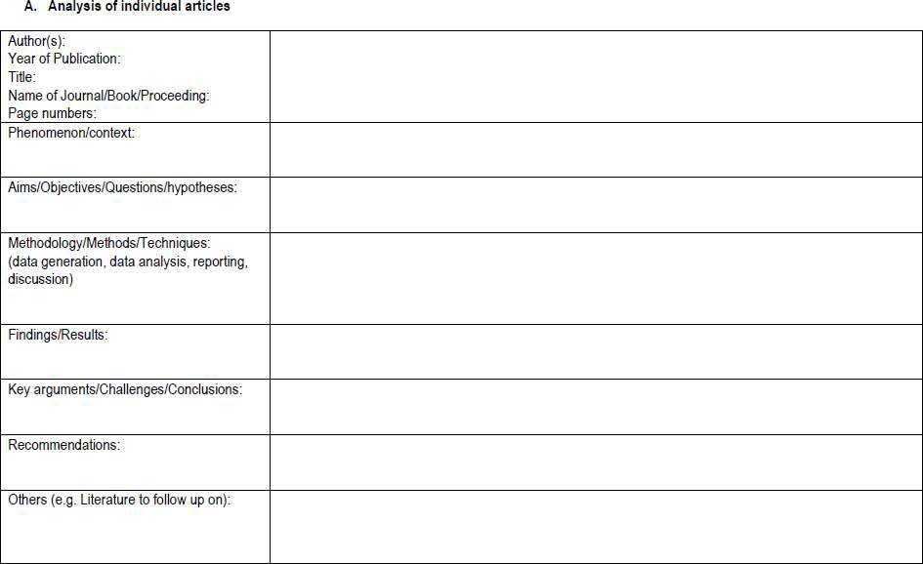
Literature Analysis & Synthesis Table
SCIENCE | TECHNOLOGY | INNOVATION | BUSINESS | DESIGN

Slide 19
Reviewing Articles: Problem Statements
How did the authors…???
explain the research challenge
integrate context into the discussion
explain the significance, scope, constraints, of research
Is there a pattern to how various articles outline their introductory section?
SCIENCE | TECHNOLOGY | INNOVATION | BUSINESS | DESIGN

Slide 20
Reviewing Articles: Research Design
How did the authors…???
outline the research design (data collection, analysis, etc.)
outline their data collection steps
outline their data analysis steps
justify the measurement / analysis protocols applied
SCIENCE | TECHNOLOGY | INNOVATION | BUSINESS | DESIGN

Slide 21
Reviewing Articles: Research Design
How accurate and valid are the measurement / analysis process compared to what other papers have suggested?
How did they justify the relevance of their approach to the research question?
SCIENCE | TECHNOLOGY | INNOVATION | BUSINESS | DESIGN

Slide 22
Reviewing Articles: Critical Analysis
Have I compared and contrasted various research items to identify common areas and points of difference?
Have I assessed the ideas and knowledge in the articles, discussing their strengths and weaknesses?
Have I cited and discussed studies that applied different techniques that may be relevant to my research plan?
SCIENCE | TECHNOLOGY | INNOVATION | BUSINESS | DESIGN

Slide 23
Evaluating Writing Techniques and Skills
How did the authors…???
relate their ideas to others
identify what is known and what remains to be known
justify or explain their arguments
highlight or acknowledge limitations, caveats or blind spots, as well as contested ideas / techniques in the literature
SCIENCE | TECHNOLOGY | INNOVATION | BUSINESS | DESIGN

Slide 24
Evaluating Writing Techniques and Skills
How did the authors…??? (advanced skills)
claim novelty for their work
acknowledge debts / work that inspired current research
display allegiances / identify theoretical positions
SCIENCE | TECHNOLOGY | INNOVATION | BUSINESS | DESIGN

Slide 25
Evaluating Writing Techniques and Skills
How did the authors organise ideas (macro structure)
Familiarity (from what is known to what is yet unknown)
Complexity (from the simple to the complex)
Claims & Arguments (from the uncontested to the contested)
Flow (from the general to the particular)
Chronology (from the past to the present)
You must identify a clear structure to avoid summarising ideas instead of evaluating them
SCIENCE | TECHNOLOGY | INNOVATION | BUSINESS | DESIGN

Slide 26
References & Further Reading
- Taylor, D and Procter, M. (2012), The Literature Review: A few tips on conducting it, www.advice.writing.utoronto.ca.
Breda University of Applied Sciences, LibGuides;General guides;Information Skills Toolbox, https://buas.libguides.com/c.php?g=670074&p=4776470
Swinburne Library, https://www.swinburne.edu.au/library/
SCIENCE | TECHNOLOGY | INNOVATION | BUSINESS | DESIGN

